Slide 1


Data-Intensive Distributed Computing
CS 451/651 (Fall 2018)
The Final Part
November 29, 2018
Jimmy Lin
David R. Cheriton School of Computer Science
University of Waterloo
These slides are available at http://lintool.github.io/bigdata-2018f/
This work is licensed under a Creative Commons Attribution-Noncommercial-Share Alike 3.0 United States See http://creativecommons.org/licenses/by-nc-sa/3.0/us/ for details

Slide 2
The datacenter is the computer!
“Big ideas”
*
Scale “out”, not “up”
Limits of SMP and large shared-memory machines
*
Assume that components will break
Engineer software around hardware failures
*
Move processing to the data
Cluster have limited bandwidth, code is a lot smaller
Process data sequentially, avoid random access
Seeks are expensive, disk throughput is good

Slide 3
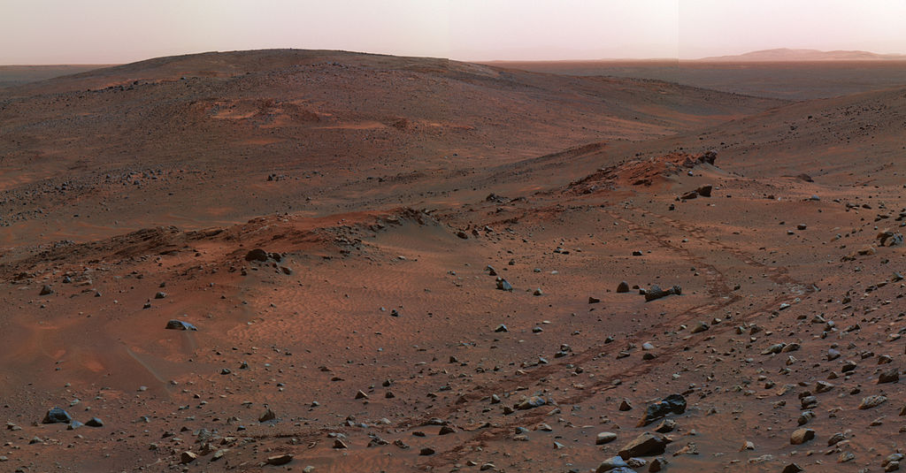
Source: NASA/JPL

Slide 4
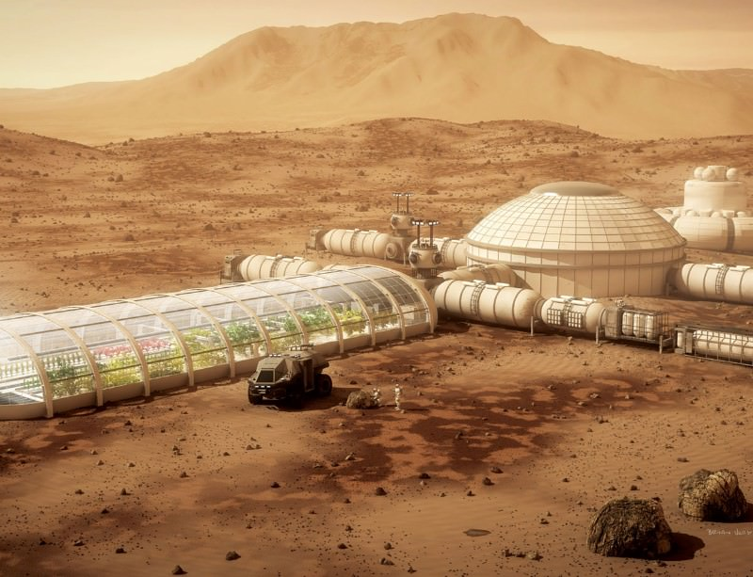
Humans will colonize Mars
Sooner than you think
Source: https://www.newscientist.com/article/dn23542-how-to-build-a-mars-colony-that-lasts-forever/

Slide 5
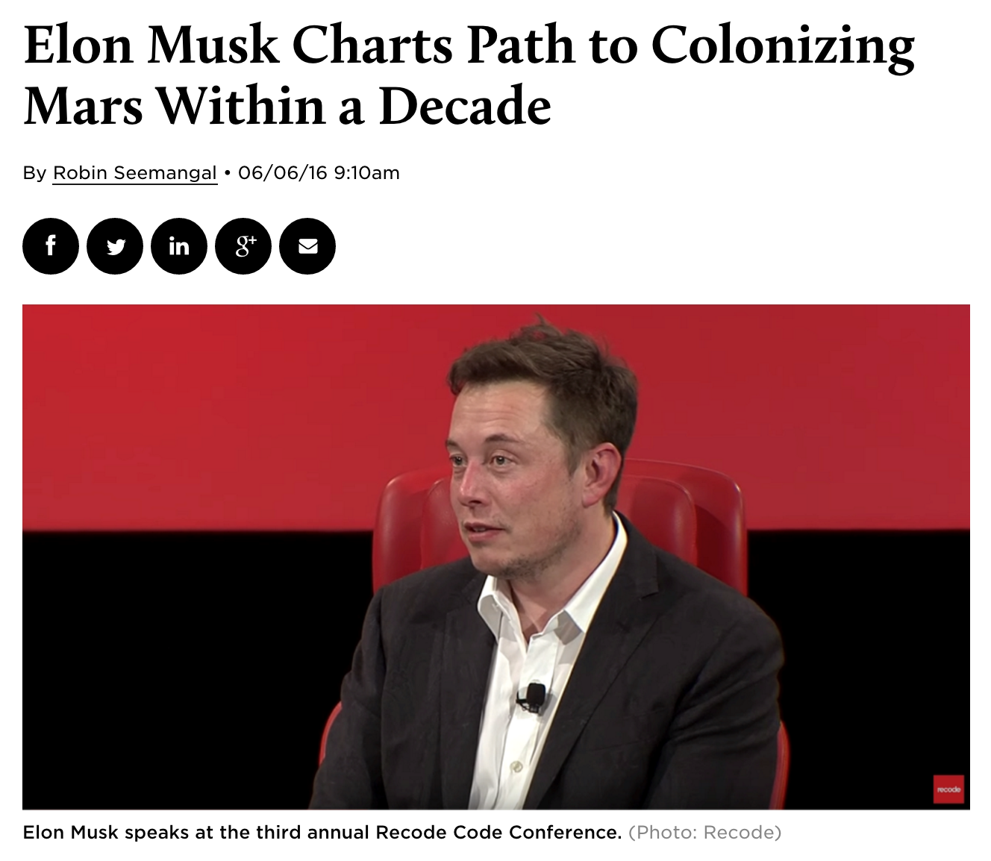
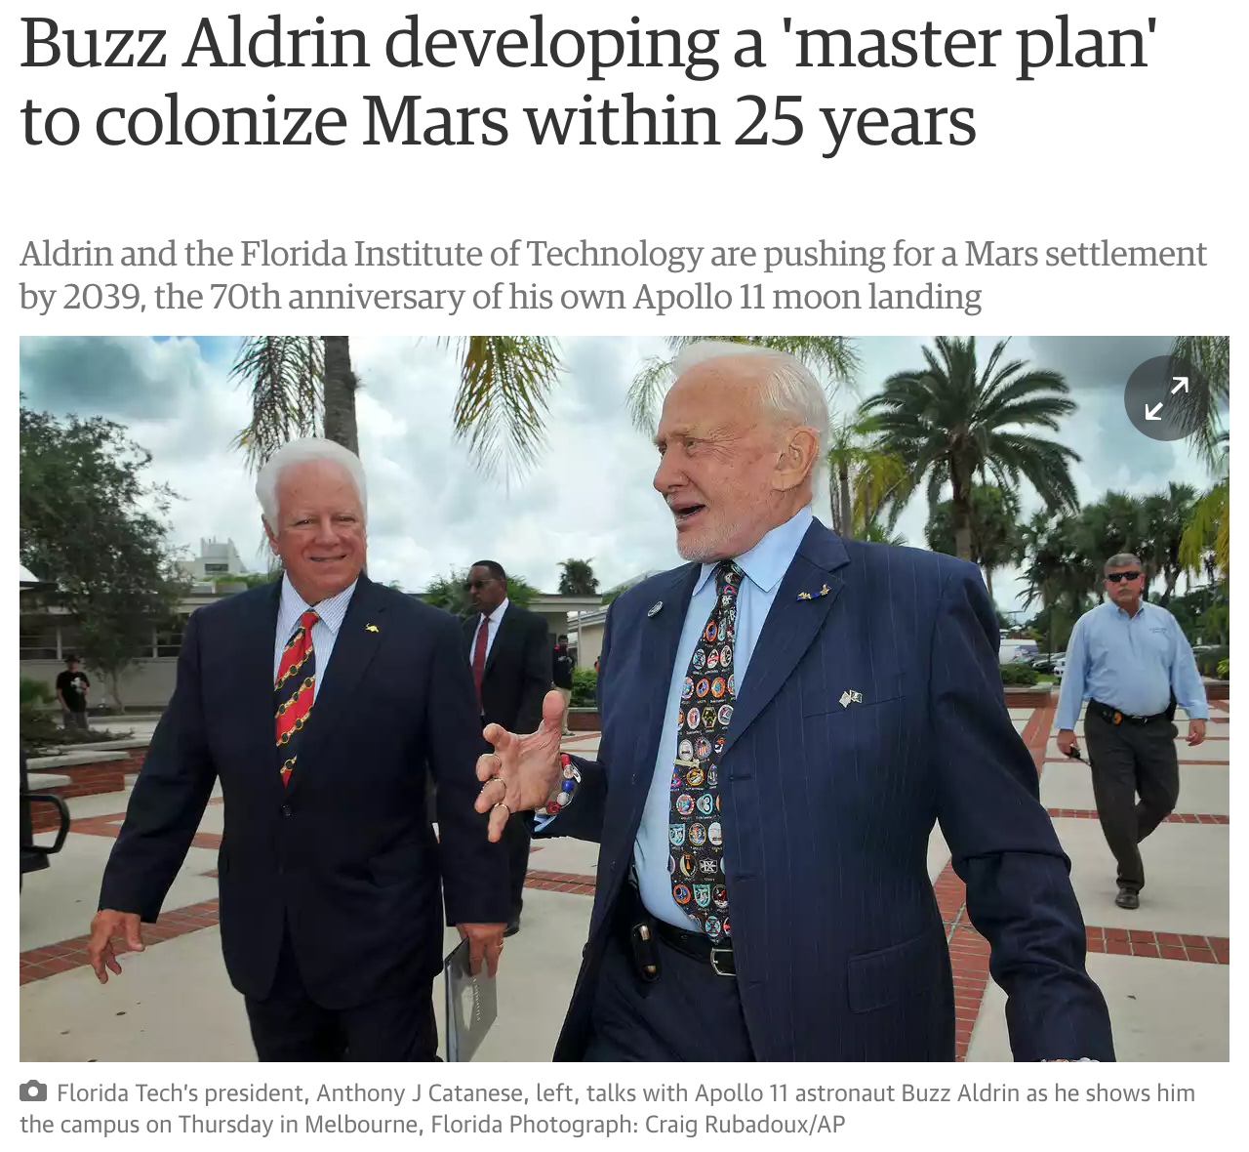
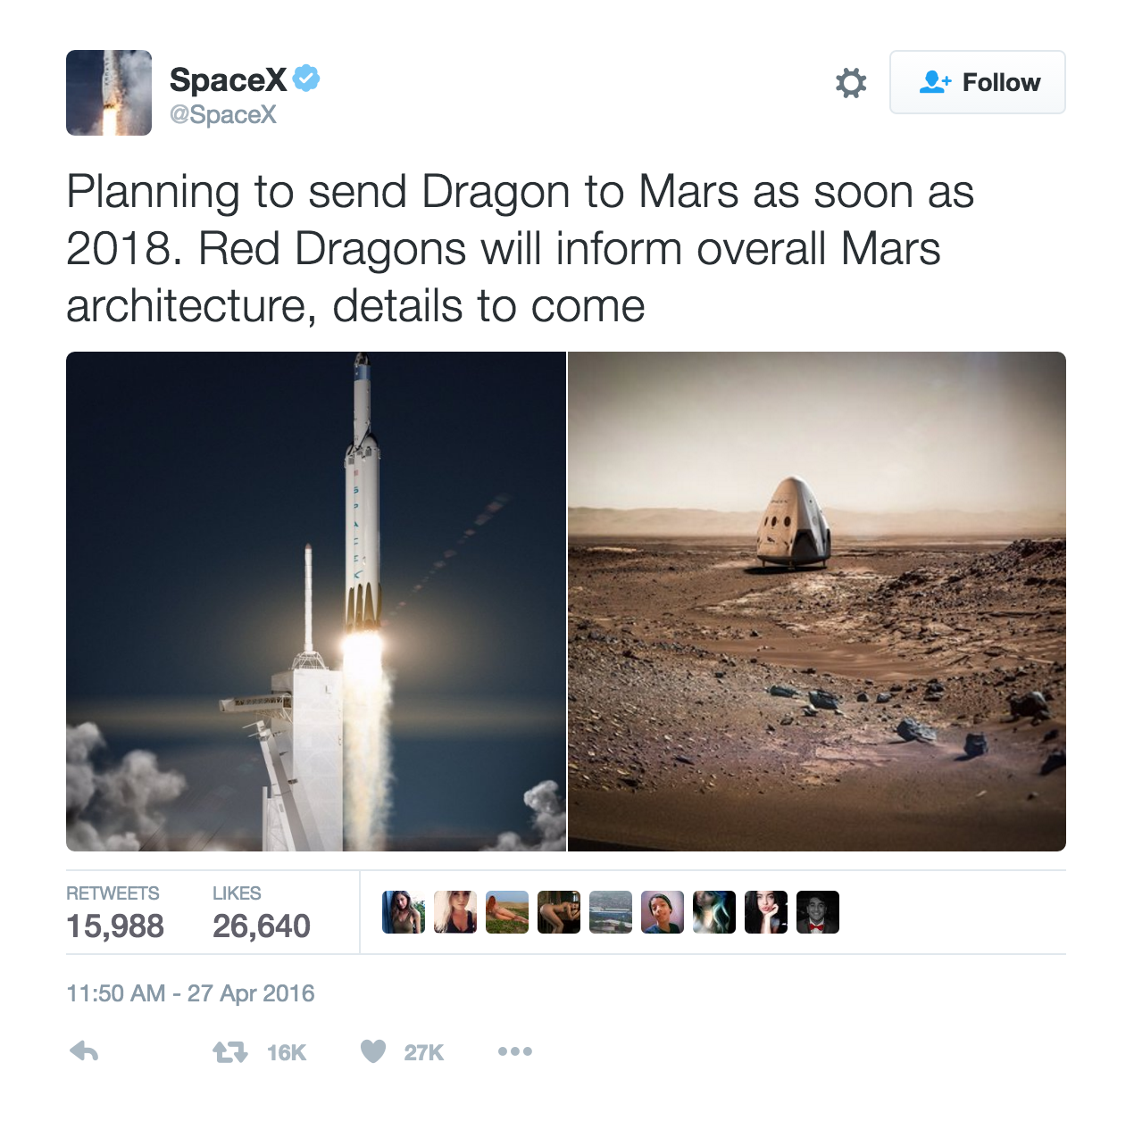
Source: https://www.theguardian.com/science/2015/aug/27/buzz-aldrin-colonize-mars-within-25-years
Source: https://twitter.com/SpaceX/status/725351354537906176
Source: http://observer.com/2016/06/elon-musk-charts-path-to-colonizing-mars-within-a-decade/

Slide 6
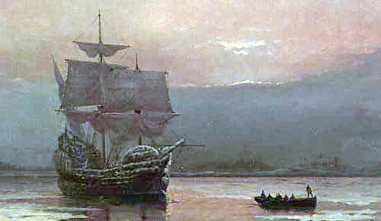
“Mars can’t just be a one-shot mission” – Buzz Aldrin
“The Pilgrims on the Mayflower came here to live and stay. They didn’t wait around Plymouth Rock for the return trip, and neither will people building up a population and a settlement [on Mars].”
Source: Mayflower in Plymouth Harbor by William Halsall (1882)

Slide 7
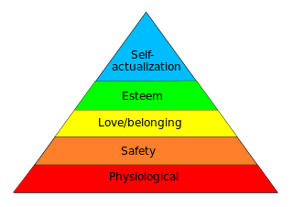
Needs
Produce breathable air
Grow food
Build shelter
Mine fuel and materials
“Staying alive”
Conduct science
Connect with family and friends
Engage in leisure activities
Search the web
“Staying sane”
Maslow's hierarchy of needs

Slide 8
Searching the web should be as easy
from Mars as it is from Marseille!
The fundamental problem: Latency
speed of light: 2-24 minutes
rockets: 5-10 months
Bandwidth is “reasonable”
Lunar Laser Communications Demonstration: 622-Mbps downlink, 20-Mbps uplink
SneakerNet on rockets: Easily PBs

Slide 9
What’s doable, what’s not?

Slide 10
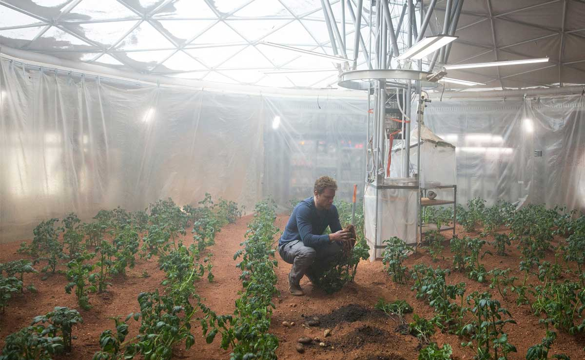
Example: How do I grow potatoes
in recycled organic waste?
Source: 20th Century Fox

Slide 11
Search from Mars: Implementation
Step 1. Rocket SneakerNet
Step 2. Beam the diffs
We know exactly how to do this!
Step 3. User model activate!
We have a good idea how to do this!
It’s a caching problem!
We’ve worked out some simulations already…
C. Clarke, G. Cormack, J. Lin, and A. Roegiest. Ten Blue Links on Mars. WWW 2017. J. Lin, C. Clarke, and G. Baruah. Searching from Mars. IEEE Internet Computing, 20(1):78-82, 2016.

Slide 12

For the truly skeptical…
Search from Mars ~ Search from regions on Earth with poor connectivity
Easter Island
Canadian Arctic
Villages in rural India
More “down to Earth” applications!

Slide 13
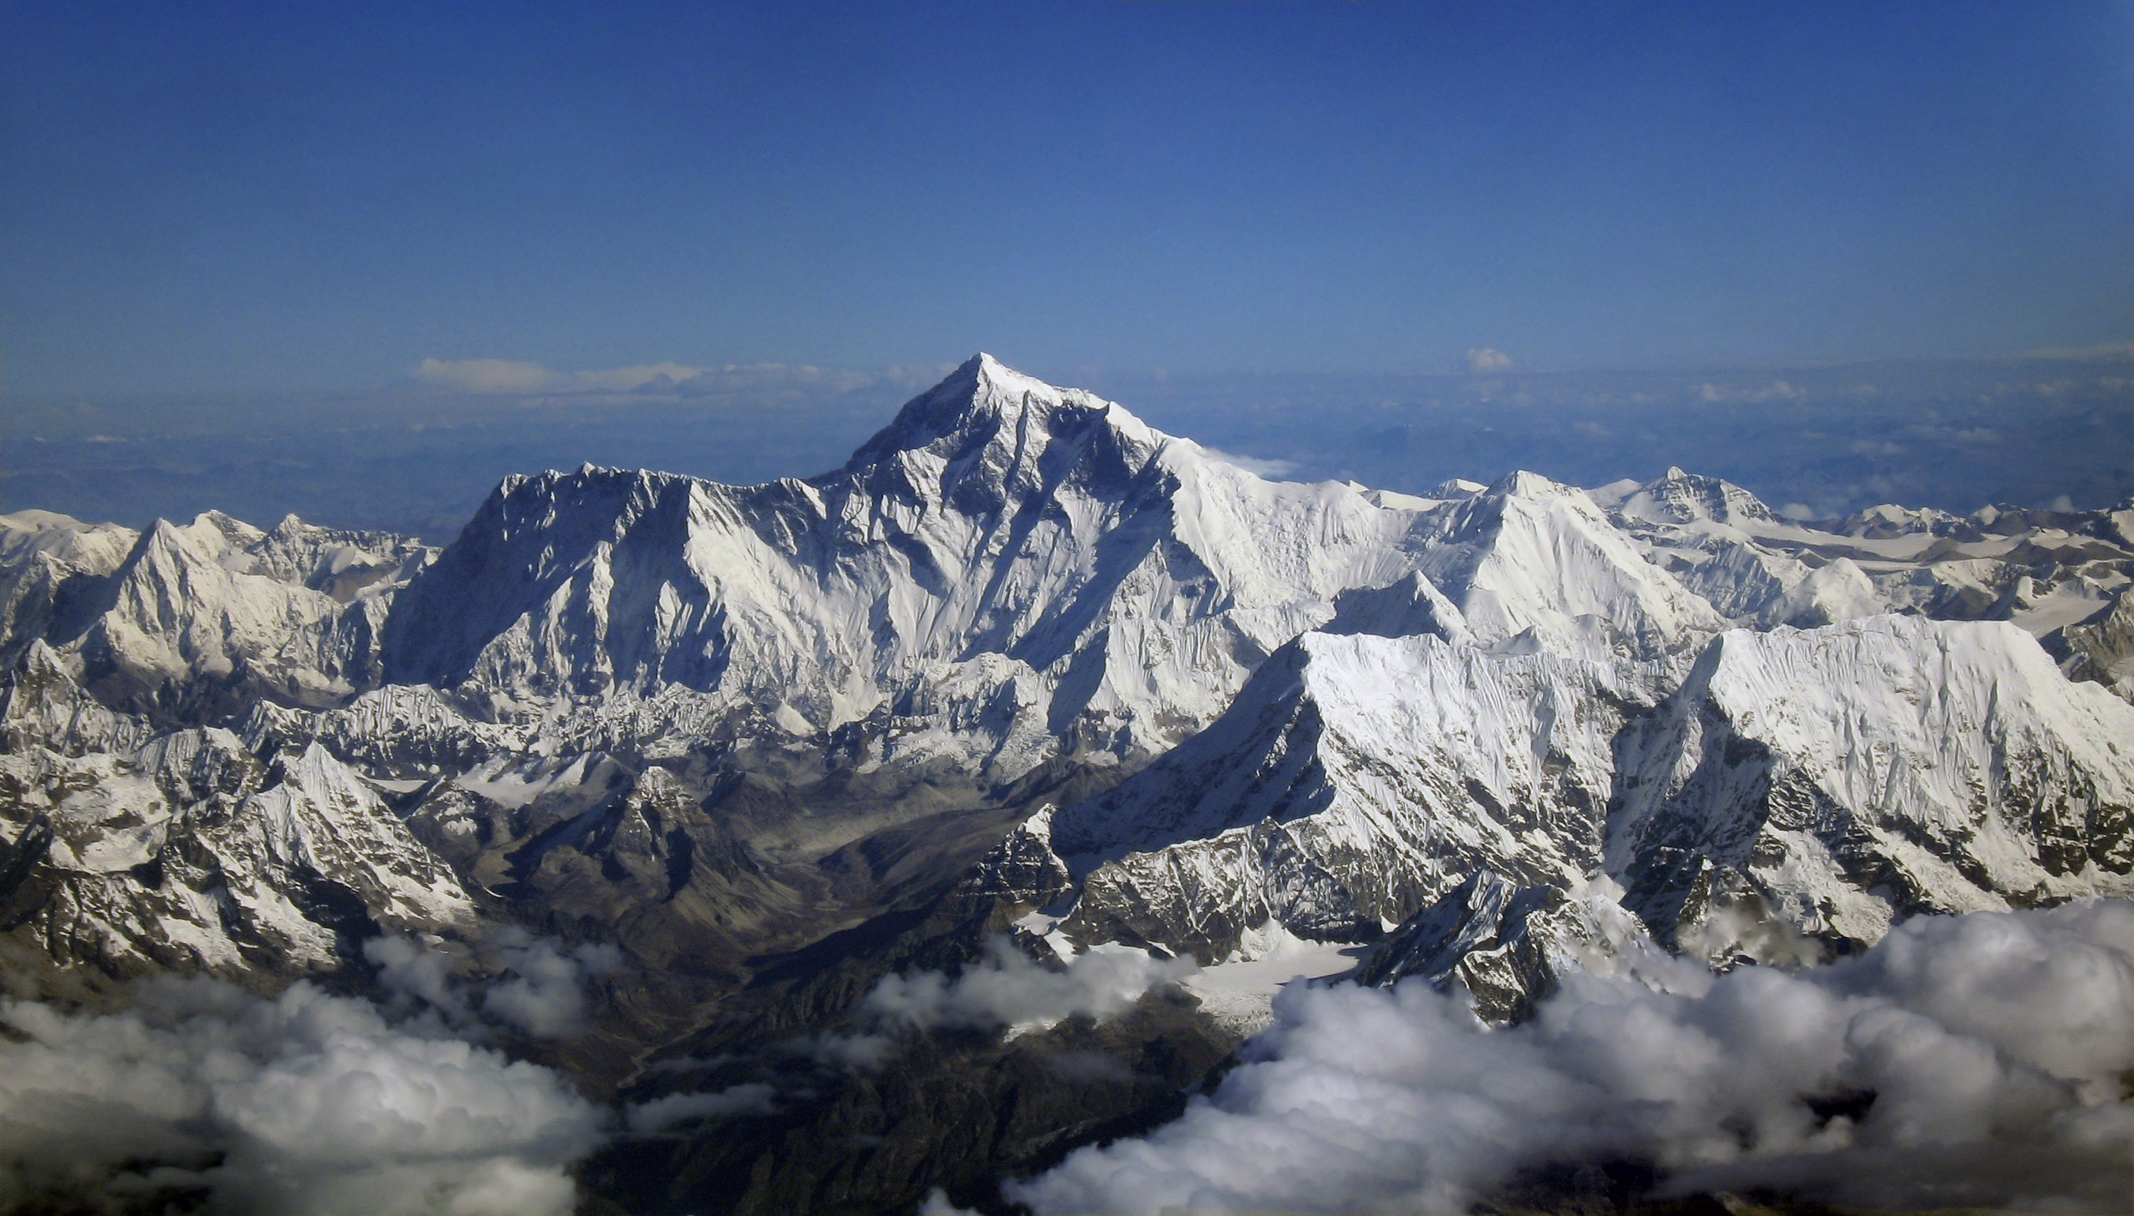
Big Data
Source: Wikipedia (Everest)

Slide 14
What’s growing faster?
Big Data
Moore’s Law
What do I mean here?
What do I mean here?
Big Data > Moore’s Law
Big Data < Moore’s Law
Big Data ~ Moore’s Law
First, a story…
J. Lin. Is Big Data a Transient Problem? IEEE Internet Computing, 19(5):86-90, 2015.

Slide 15
What’s growing faster?
Big Data
Moore’s Law
Let’s restrict to Human-generated data
Bounds?
Human population
Data generation per unit time

Slide 16
Big Data > Moore’s Law
Big Data < Moore’s Law
Big Data ~ Moore’s Law
Implications?
Back to my story…

Slide 17
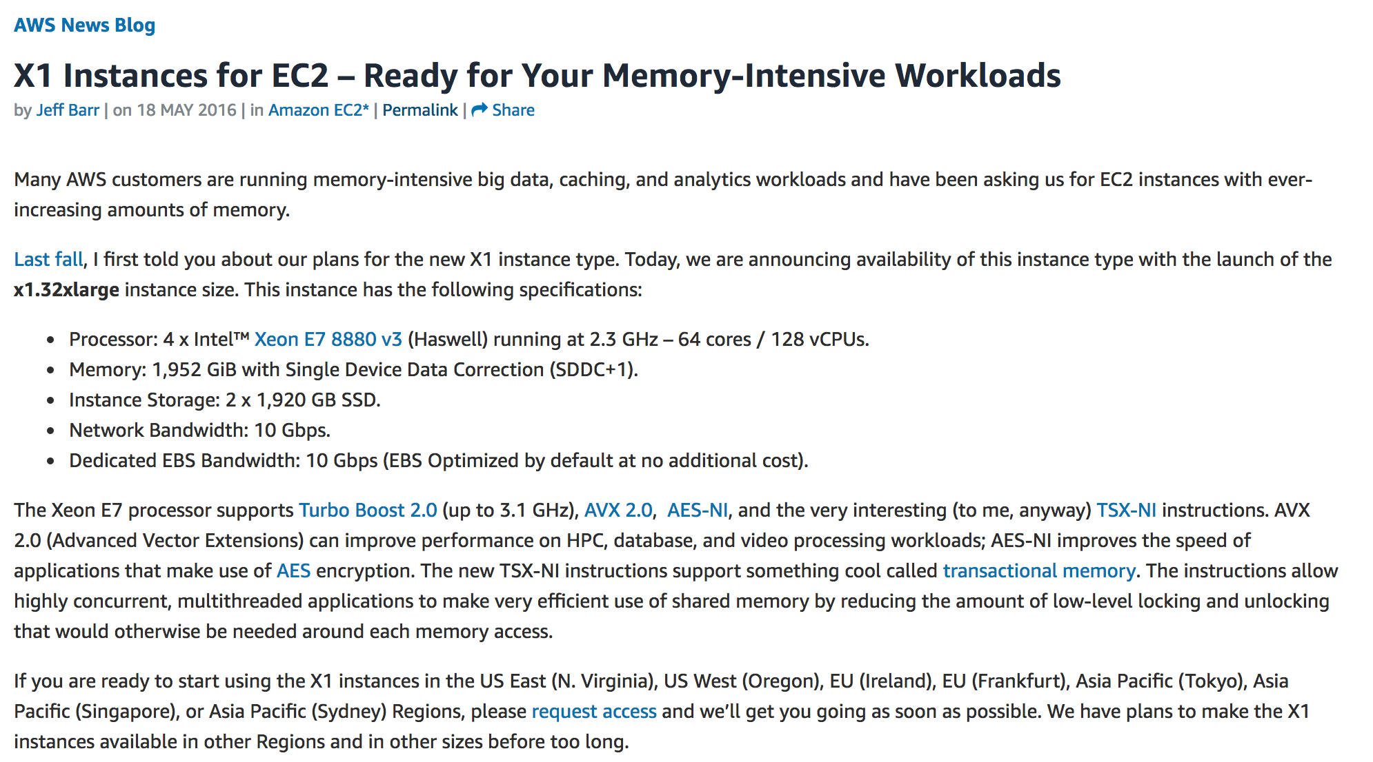
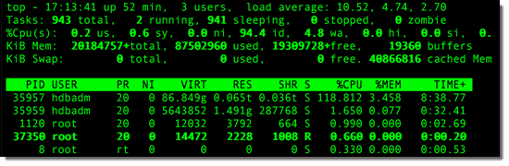

Slide 18
What’s growing faster?
Big Data
Moore’s Law
Let’s restrict to Human-generated data
What am I forgetting?
Bounds?
Human population
Data generation per unit time

Slide 19
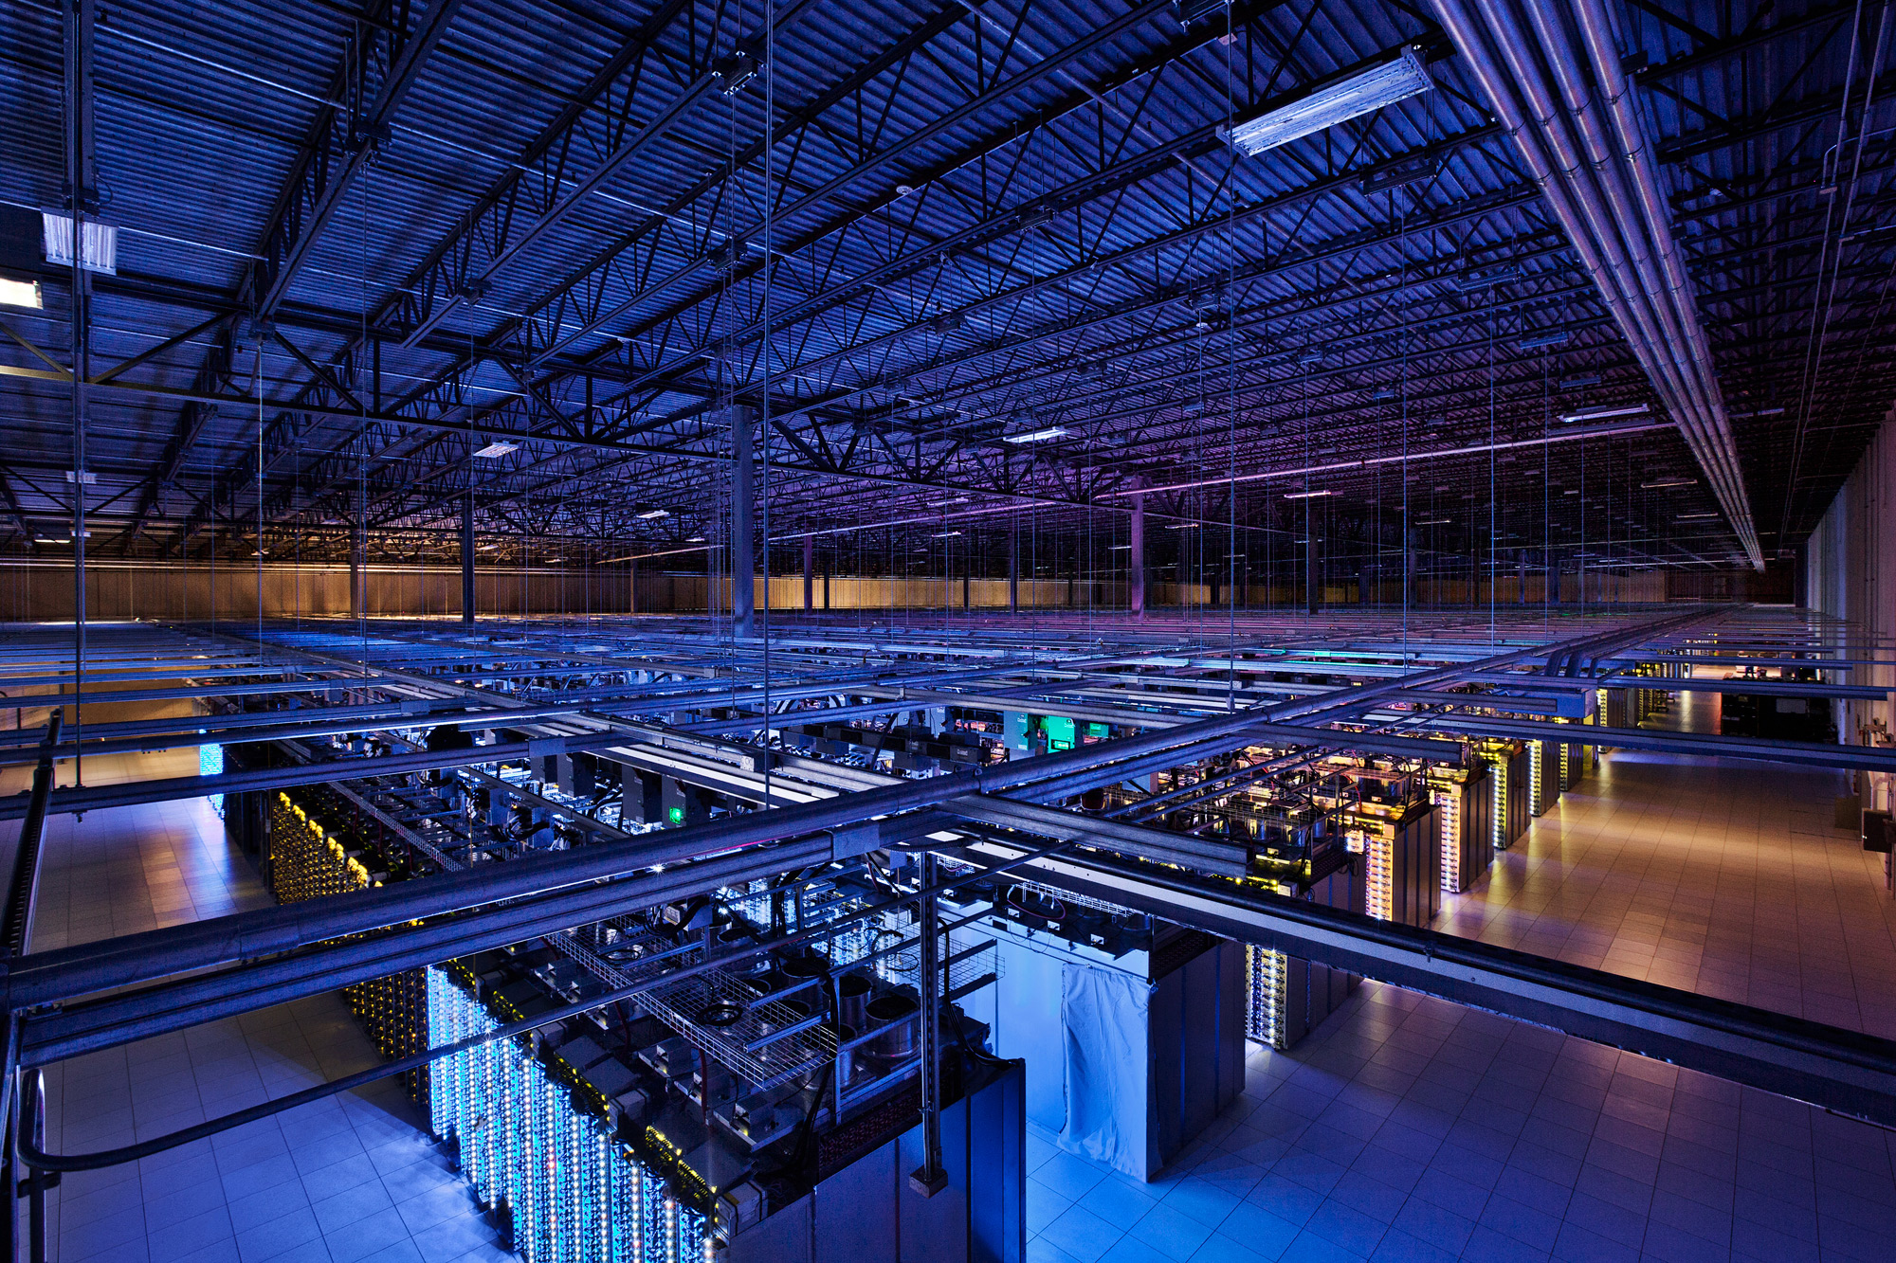
Serverless Architectures
Source: Google

Slide 20
Server

Slide 21
Processor
Processor
Processor
Processor
Memory
Memory
Memory
Memory
Disk
Disk
Disk
Disk
Server
Server
Server
Server

Slide 22
Processor
Processor
Processor
Processor
Memory
Memory
Memory
Memory
Disk
Disk
Disk
Disk
Persistent?
(Virtualized) Server
(Virtualized) Server
(Virtualized) Server
(Virtualized) Server
Cloud
(I’m going to illustrate with AWS)

Slide 23
Persistent Store (S3)
Processor
Processor
Processor
Processor
Memory
Memory
Memory
Memory
Disk
Disk
Disk
Disk
(Virtualized) Server
(Virtualized) Server
(Virtualized) Server
(Virtualized) Server
Cloud

Slide 24
Persistent Store (S3)
Processor
Processor
Processor
Processor
Memory
Memory
Memory
Memory
(scratch) Disk
(scratch) Disk
(scratch) Disk
(scratch) Disk
(Virtualized) Server
(Virtualized) Server
(Virtualized) Server
(Virtualized) Server
Cloud

Slide 25
“State” as a service (S3, RDS, SQS, …)
Processor
Processor
Processor
Processor
Memory
Memory
Memory
Memory
?
(scratch) Disk
(scratch) Disk
(scratch) Disk
(scratch) Disk
(Virtualized) Server
(Virtualized) Server
(Virtualized) Server
(Virtualized) Server
Cloud

Slide 26
“State” as a service (S3, RDS, SQS, …)
Processor
Processor
Processor
Processor
Memory
Memory
Memory
Memory
?
(Virtualized) Server
(Virtualized) Server
(Virtualized) Server
(Virtualized) Server
Cloud

Slide 27
“State” as a service (S3, RDS, SQS, …)
Processor
Processor
Processor
Processor
Memory
Memory
Memory
Memory
Function
(Virtualized) Server
(Virtualized) Server
(Virtualized) Server
Cloud

Slide 28
“State” as a service (S3, RDS, SQS, …)
Processor
Processor
Processor
Processor
Memory
Memory
Memory
Memory
FaaS
FaaS
FaaS
FaaS
Cloud

Slide 29
Serverless Architectures
Doesn’t mean you don’t have servers
Just that managing them is the cloud provider’s problem
Write functions with well-defined entry and exit points
Cloud provider handles all other aspect of execution

Slide 30
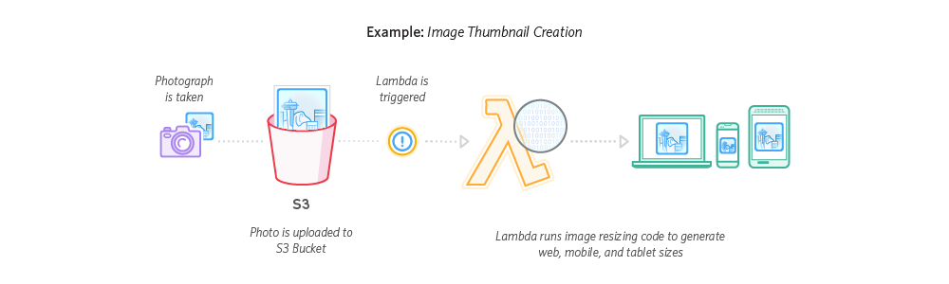
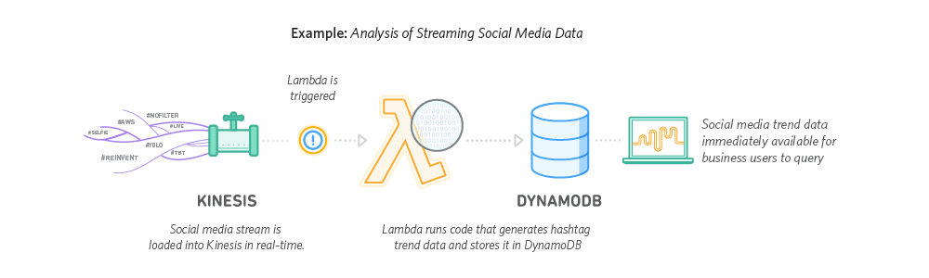
Source: Amazon Web Services

Slide 31
(Current) Serverless Architectures
Asynchronous, loosely-coupled, event-driven
Functions touch relatively little data
What about serverless data analytics?
Design goal: pure pay-as-you-go, zero costs for idle capacity
Compared to current options?

Slide 32
Flint
PySpark execution backend
Youngbin Kim and Jimmy Lin. Serverless Data Analytics with Flint. IEEE Cloud 2018.

Slide 33
The datacenter is the computer!
“Big ideas”
*
Scale “out”, not “up”
Limits of SMP and large shared-memory machines
*
Assume that components will break
Engineer software around hardware failures
*
Move processing to the data
Cluster have limited bandwidth, code is a lot smaller
Process data sequentially, avoid random access
Seeks are expensive, disk throughput is good

Slide 34
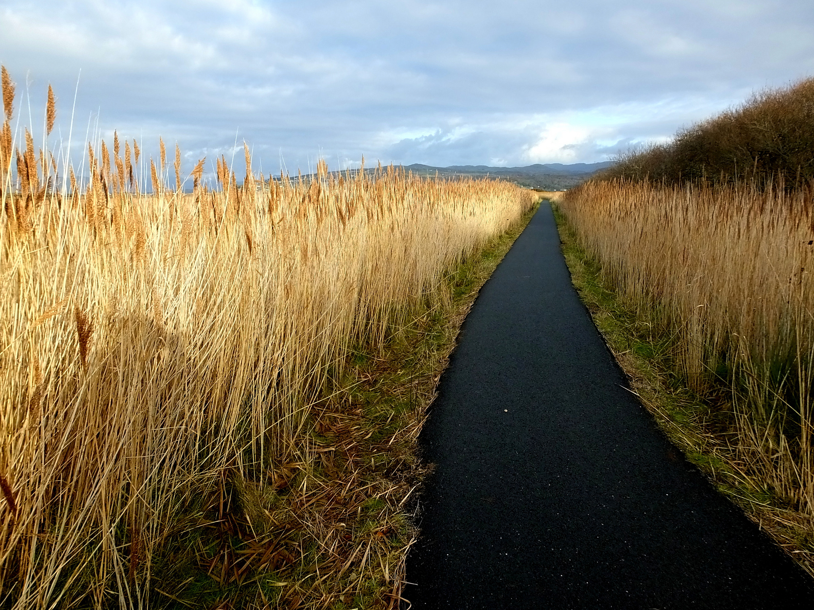
Source: flickr (https://www.flickr.com/photos/39414578@N03/16042029002)

